Slide 1
Secure data hiding in image using steganography
CAPSTONE PROJECT
Presented By:
Student Name : Ilma Fatma
College Name & Department : Zakir Hussain College Of Engineering And Technology (Department Of Electrical Engineering)

Slide 2
OUTLINE
Problem Statement
Technology used
Wow factor
End users
Result
Conclusion
Git-hub Link
Future scope

Slide 3
Problem Statement
Concealing the Existence of a Message: This is the basic problem statement in steganography, where the task is to hide a message in another piece of information (e.g., an image, audio file, etc.) without leaving any visible signs that the message is there.It involves hiding a message so that it can only be read by authorised parties and providing a level of security to protect the message from being read by unauthorised parties.

Slide 4
Technology used
Python Idle
Libraries:
cv2
os
string
Open-cv
Web Browser
Visual Studio Code

Slide 5
Wow factors
What makes this project stand out from other project?
It includes a whole host of techniques, and one which standards out is steganography which comes from steganos, or covered. What makes steganography unique is that it is a technique of making information hard to find, not hard to read once found.

Slide 6
End users
Ethical hackers
Forensics examiners
Spies
Government security
Intelligence agencies

Slide 7
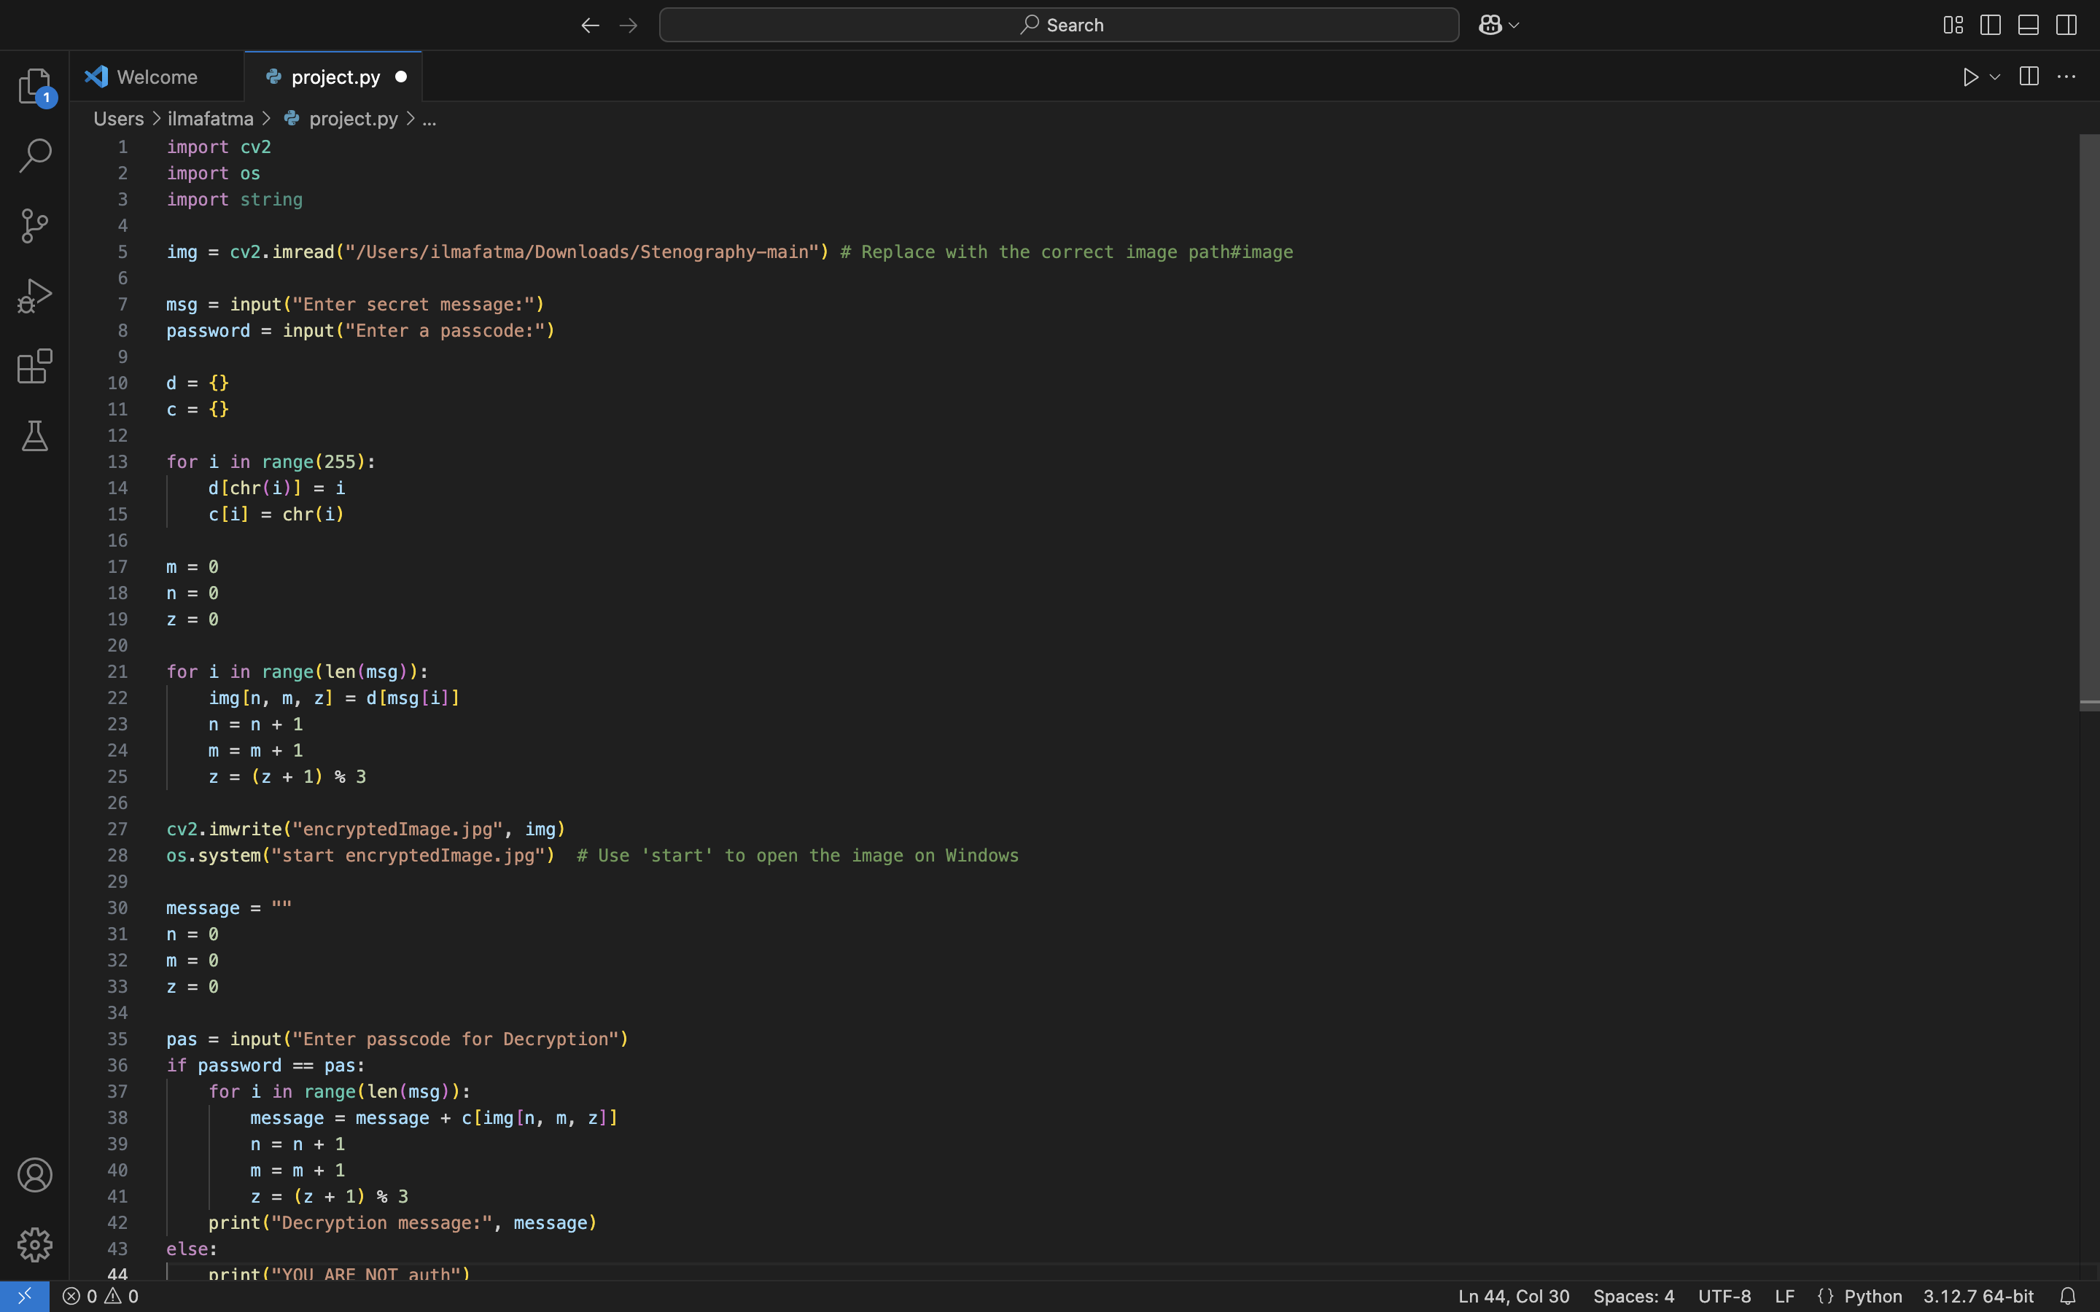

Results

Slide 8
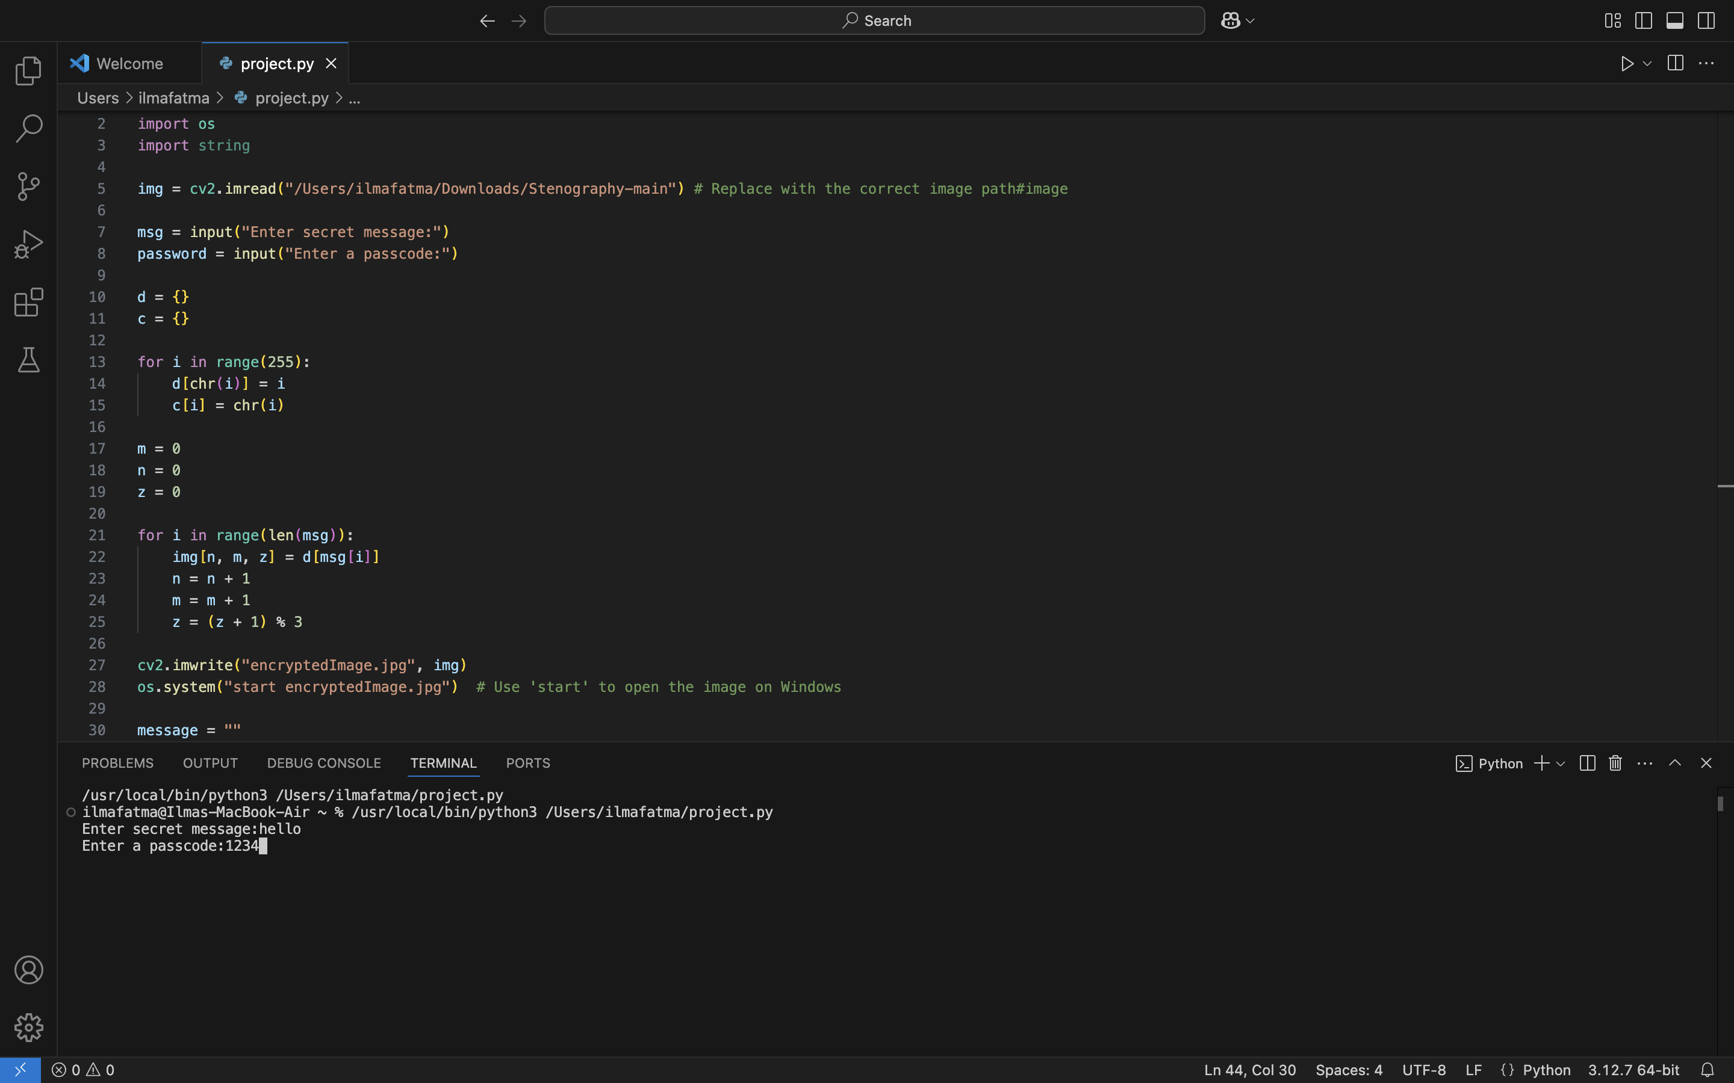
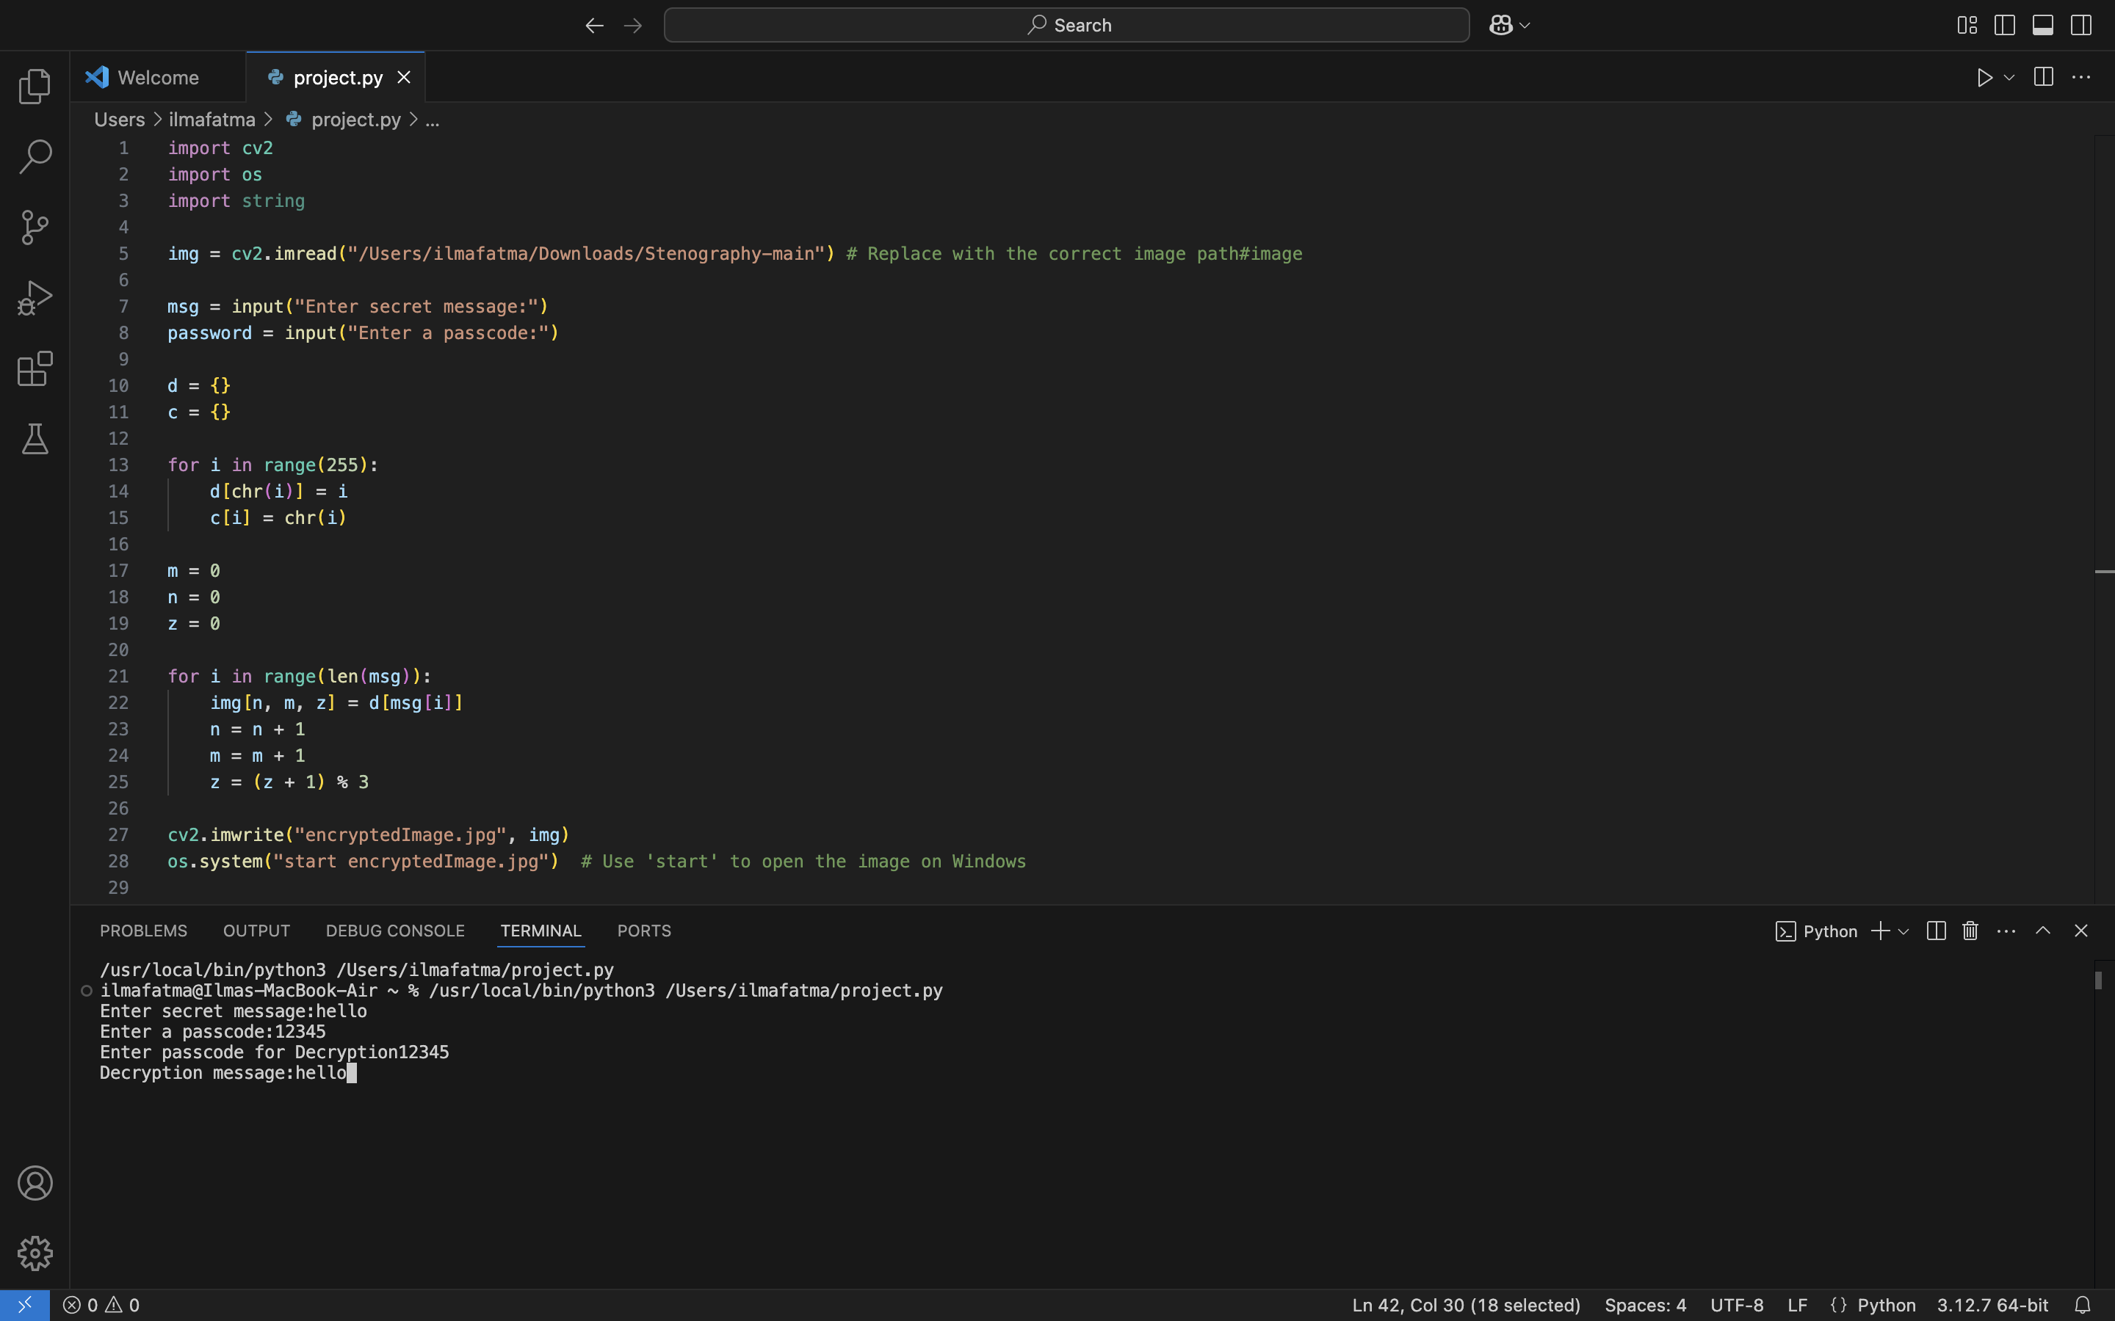
Results

Slide 9
Conclusion
Steganography is a powerful and versatile technique for hiding information in other data. The technique has a long history and has been adapted for use in the digital age to meet the demands of modern security and privacy needs.
Steganography provides a way to transmit confidential information securely and covetable manner and is often used as an alternative or complement to cryptography. By embedding secret messages in cover media, steganography allows individuals and organizations to protect sensitive information from prying eyes and ensure the confidentiality of their communications.

Slide 10
GitHub Link
https://github.com/IlmaFatma/My-project-

Slide 11
Future scope(optional)
A recent study published in the Intell Rev journal presented a novel approach to data hiding that leverages pixel value differencing and modification directions for improved security. In another research, scientists proposed an adaptive multi-bit-plane image steganography technique utilizing block data- hiding methods. These findings shed light on innovative solutions for securing digital information.

Slide 12
THANK YOU

